Slide 1


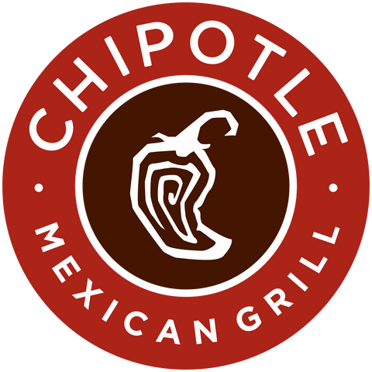
Automation and Avocados: Chipotle’s Strategic Response to Economic Pressures
GROUP 4
PROF MARK TUMINELLO
CHINTAN S. JIKKAR | SYRGA IBRAEVA | DILAN A. PATEL
ISHA CHAUHAN | ABHISHEK PRAKASH | VRAJ N. THAKKAR SEDEN DILMACLI
Notes:
Good afternoon everyone — I’m Chintan, and I’ll be starting us off by laying the foundation for today’s presentation.

Slide 2

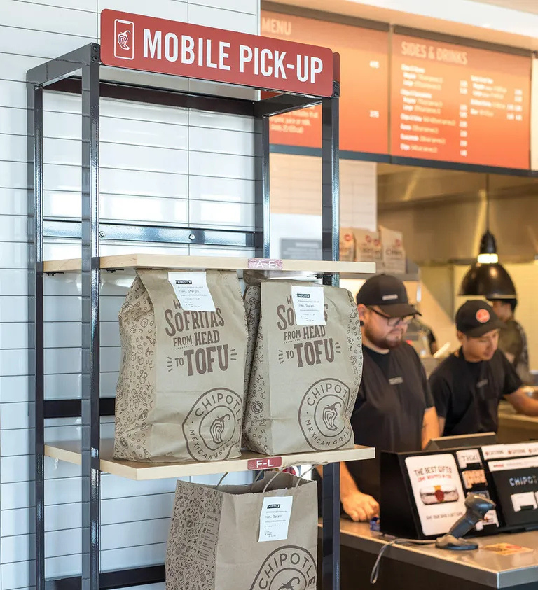


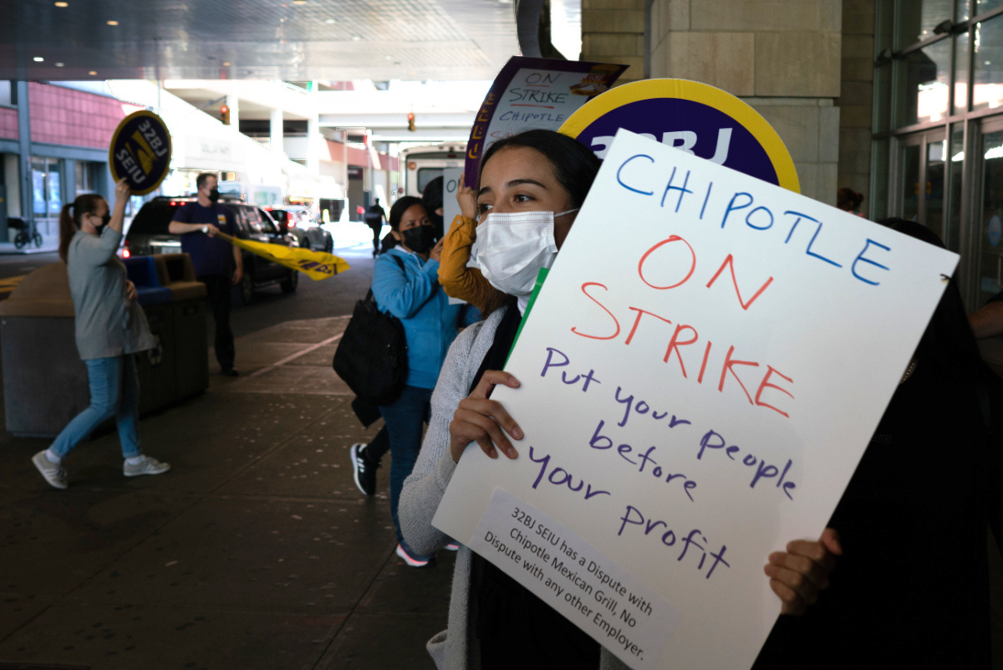
Introduction
The Economic Landsacpe
Inflation, wage hikes, labor strain
Digital & automation at center of response
Six economic lenses guide our analysis
Notes:
So picture this: it’s early 2024. Inflation is climbing, labor shortages are everywhere, and the cost of doing business is rising fast — especially in food service. In this kind of climate, most companies either raise prices blindly or cut corners.
But Chipotle doesn’t do either.
Instead, it takes a much more strategic path. The company invests in automation. It leverages digital ordering to lock in customer loyalty. It reshapes how it hires, prices, and sources ingredients — not just to survive, but to adapt intelligently.
That’s the story we’re telling today.
Our group analyzed Chipotle through the lens of six key economic concepts — from macroeconomic pressures and labor costs, to consumer choice theory, market structure, and international trade dynamics.
Each of us will walk you through how these factors affect Chipotle — and more importantly, how the company is turning them into opportunities.
By the end of this presentation, you’ll see that what makes Chipotle successful isn’t just burritos — it’s their ability to use economics to drive every decision behind the scenes.
And with that, let’s jump into Module 1.

Slide 3


Module 1:
Macroeconomics and Economic Growth Implications
The U.S. macroeconomic environment has faced major shifts in recent years, marked by:
High inflation
Labor shortages
Slowing GDP growth
These challenges have a direct impact on businesses like Chipotle Mexican Grill.
As future business leaders, it’s essential to understand how firms adapt to external economic pressures to stay competitive and profitable.
Chipotle serves as a strong example of strategic agility in the face of macroeconomic headwinds.

Slide 4
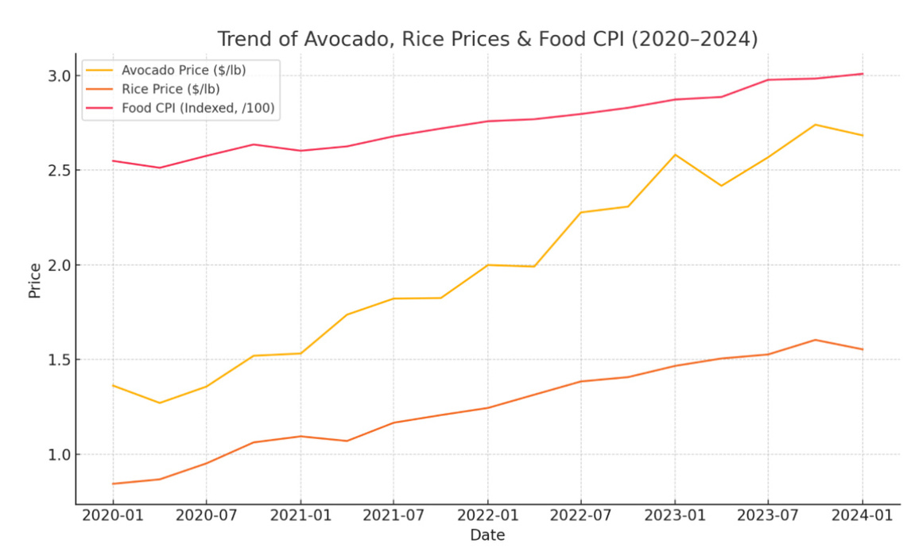

1. Inflation and Input Costs
Inflation, especially in food prices, has become a major cost challenge.
Key ingredients in Chipotle’s menu (e.g., avocados, rice) have seen price increases due to:
Climate issues affecting crops
Global supply chain disruptions
Data point: U.S. food prices rose over 10% year-over-year in 2022 (Bureau of Labor Statistics)
Impact on Chipotle:
Higher COGS (Cost of Goods Sold)
Reduced profit margins
Need to raise prices or cut other operational costs

Slide 5
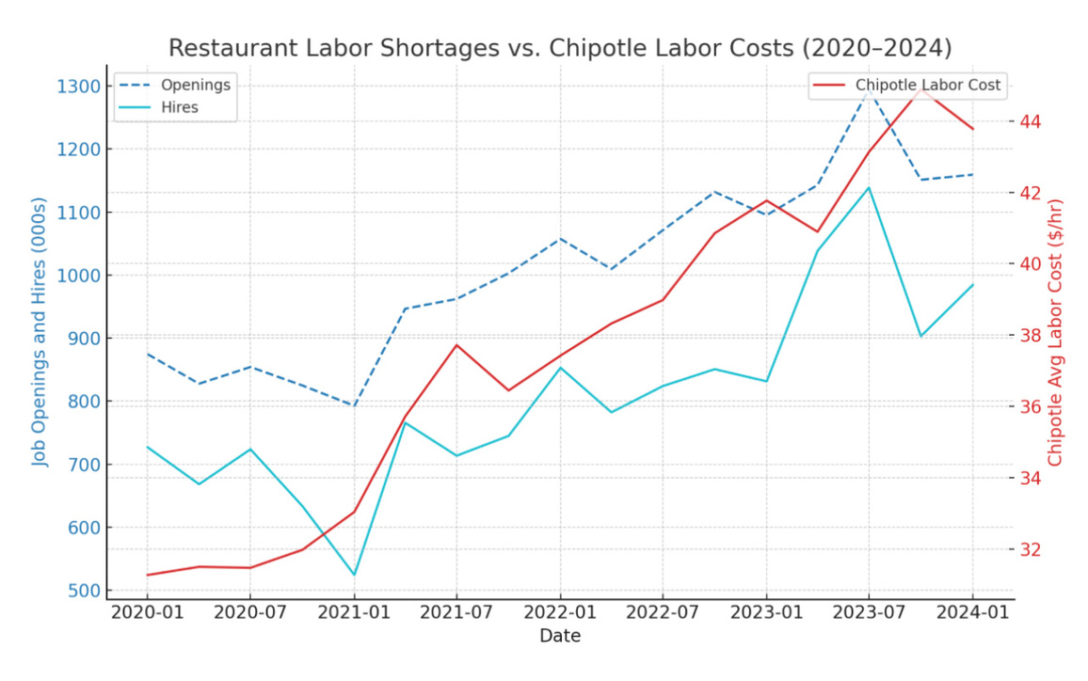

2. Labor Shortages in the Restaurant Industry
The food-service sector remains affected by a shortage of labor post-pandemic.
Causes:
Burnout from pandemic-era work conditions
Competition from higher-paying industries
62% of restaurant operators reported being understaffed in 2023 (National Restaurant Association)
Chipotle’s response:
Offering higher pay, bonuses, and benefits
Investing in automation technology like:
‘Chippy’ (AI chip-making tool)
Digital make-lines to streamline service
Shift toward capital-intensive operations to mitigate labor shortages

Slide 6
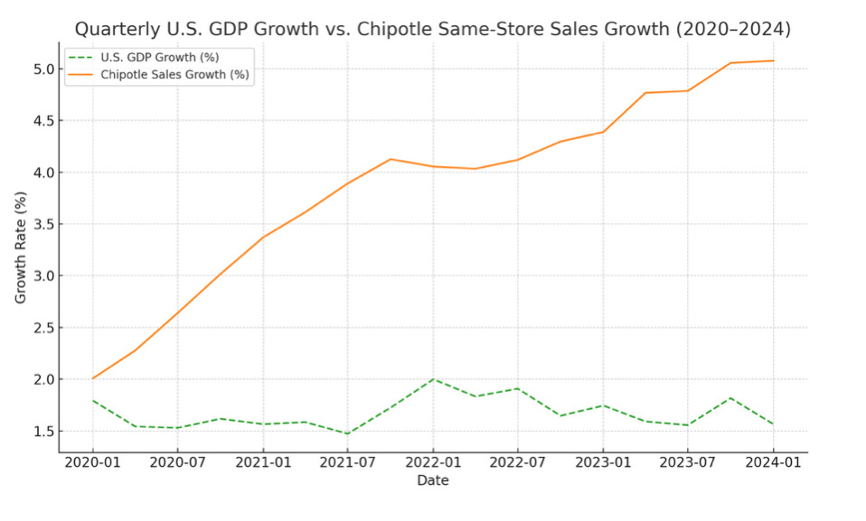

3. Slowing GDP Growth and Consumer Confidence
Slower GDP growth reduces consumer spending, particularly in non-essential sectors like dining out.
Impact on Chipotle:
Decreased restaurant visits and smaller average orders.
Company strategies:
Emphasis on value-driven digital promotions.
Strengthening loyalty programs to retain customers.
Growing digital ordering capabilities:
Enables revenue growth despite lower in-store traffic.
Keeps marginal costs low per order.

Slide 7


4. Summary & Strategic Takeaways
Macroeconomic forces are actively shaping business strategy for Chipotle.
Key challenges:
Inflation, labor shortages, and GDP slowdown
Chipotle’s effective responses:
Leveraging technology and automation
Scaling digital operations for efficiency
The brand is navigating economic pressures while protecting customer experience and profitability.

Slide 8

Overview of Chipotle's Business Model
﻿﻿Focuses on high-quality, fresh ingredients and simple menu.
﻿﻿Strong commitment to sustainability and ethical sourcing.
﻿﻿Fast-casual model with focus on speed and convenience.
Competitive Advantage
﻿﻿Unique positioning as a healthier, customizable fast-food option.
﻿﻿Strong brand loyalty due to quality, transparency, and customer experier
﻿﻿Vertical integration strategy supports cost control and quality assurance.
Financial Performance
﻿﻿Consistent revenue growth and profitability despite market challenges.
﻿﻿High average revenue per restaurant compared to competitors.
﻿﻿Efficient cost management despite premium ingredient
Strategic Analysis of Chipotle
Module 2

Slide 9

Strategic Growth & Market Position
1. Market Trends and Consumer Preferences
Health-conscious eating and demand for clean, natural ingredients.
Rise of digital ordering and delivery platforms.
Growing focus on sustainability and environmental impact.
3. Financial Resilience
Strong cash flow and balance sheet for strategic investments.﻿﻿
Efficient supply chain management tosupport rapid scaling.﻿﻿
High return on invested capital compared to peers.
2. Strategic Initiatives
Digital transformation through Chipotlanes and loyalty programs.
Focus on menu innovation to cater to diverse tastes.
Expansion into suburban and international markets.

Slide 10

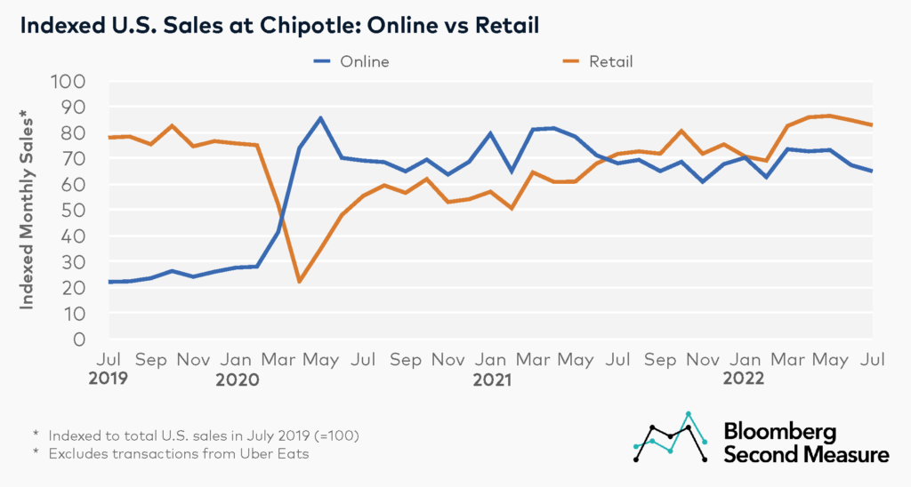

Module 3
Chipotle's Digital Leap: Speed, Satisfaction, Success
Transportation
Over 50% of sales from digital platforms (since 2021)
Smarter Pickup Times cut wait by 50%
Chipotlanes = frictionless drive-thru for app users
Automation in digital kitchens boosts speed + efficiency
Result: Convenience > price → inelastic demand
Online tutoring and course creation now attract independent gig educators worldwide.
Syrga Ibraeva
Notes:
Consumer behavior in dining has shifted drastically—especially since COVID. Chipotle recognized early on that the future of dining was digital. By 2021, digital orders made up more than half of total sales. They launched ‘Smarter Pickup Times’ to reduce wait time, and introduced Chipotlanes for seamless drive-thru pickups. Chipotle has continuously scaled its digital sales from under 20% pre-pandemic to a stable 35%+ in recent years. From an economics standpoint, demand is inelastic—customers value speed and personalization more than slight price changes. This tech-enabled approach helped Chipotle enhance consumer satisfaction and defend its market position.

Slide 11

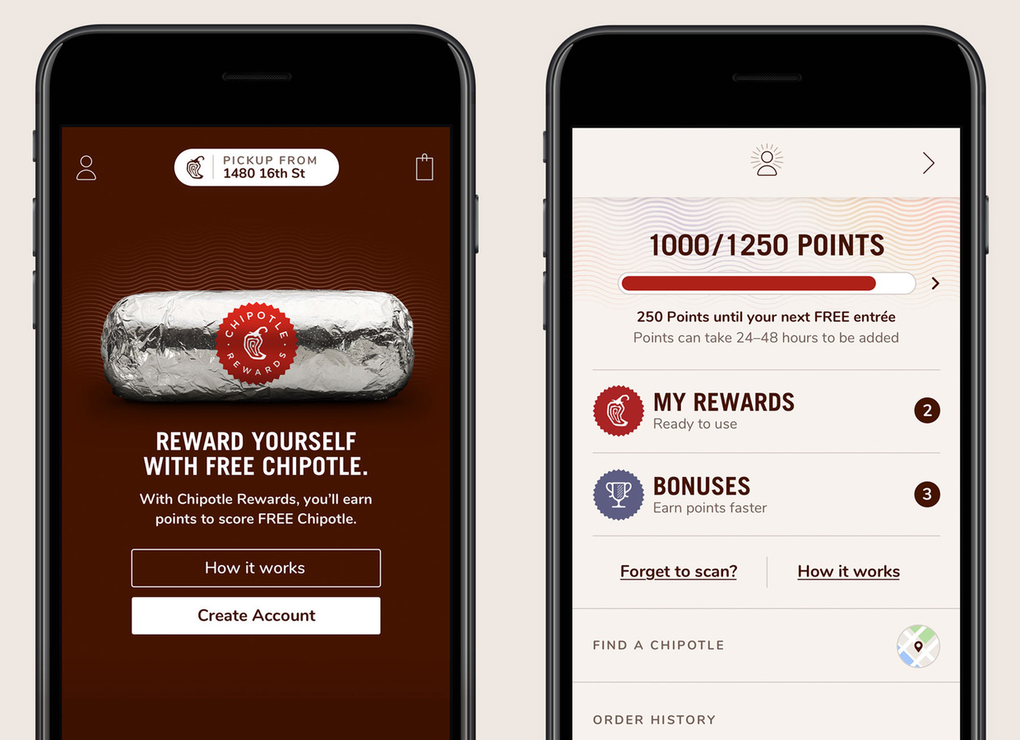



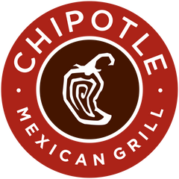
Module 3
Beating Substitutes Through Smart Integration
Transportation
Sweetgreen: sleek app + healthy menu
Panera: subscription perks, free delivery
Qdoba: free guac + queso
Chipotle: personalization, speed, deep app integration
No price ceilings/floors → flexible pricing strategy
Online tutoring and course creation now attract independent gig educators worldwide.
Notes:
Other brands like Sweetgreen and Panera have solid digital offerings—Sweetgreen with its clean design, Panera with subscriptions, and Qdoba with free extras.But Chipotle stands out through personalized rewards, app-only deals, and an interface optimized for speed. Unlike industries with regulated pricing, fast-casual restaurants like Chipotle face no price ceilings or floors, allowing them to compete dynamically using promotions and loyalty benefits instead.”

Slide 12
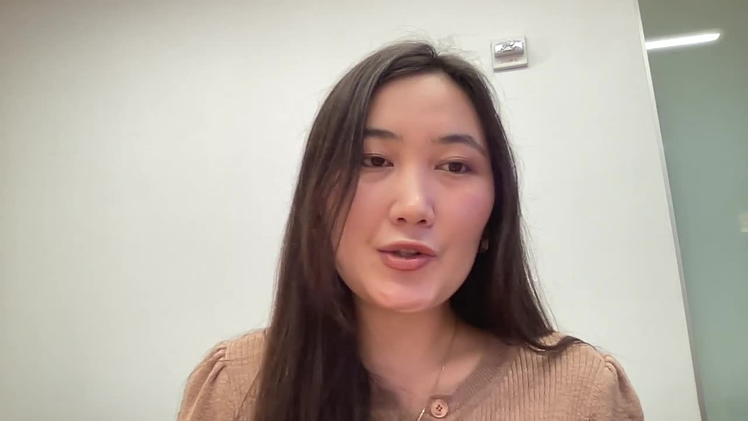
Module 3
Delivering Value Without Discounting
Feature | Chipotle | Sweetgreen | Panera Bread | Qdoba
Avg. Entrée Price | $9.10 | $10.50 | $9.00 | $10.55
Loyalty Program | Free | Free | $6.99/month | Free
Delivery Fees | Varies | Varies | Free w/ subscription | Varies
Guac Charge | Extra | Extra | Included | Included
Online tutoring and course creation now attract independent gig educators worldwide.
Notes:
Many assume price is the biggest factor—but digital users often value convenience over a dollar saved. Chipotle isn’t the cheapest option—but that hasn’t hurt its growth. App users are less price-sensitive because they prioritize ease, reliability, and rewards. The ability to customize meals, track prices transparently, and get personalized offers builds loyalty and trust. Chipotle wins by adding value digitally, not by cutting prices

Slide 13
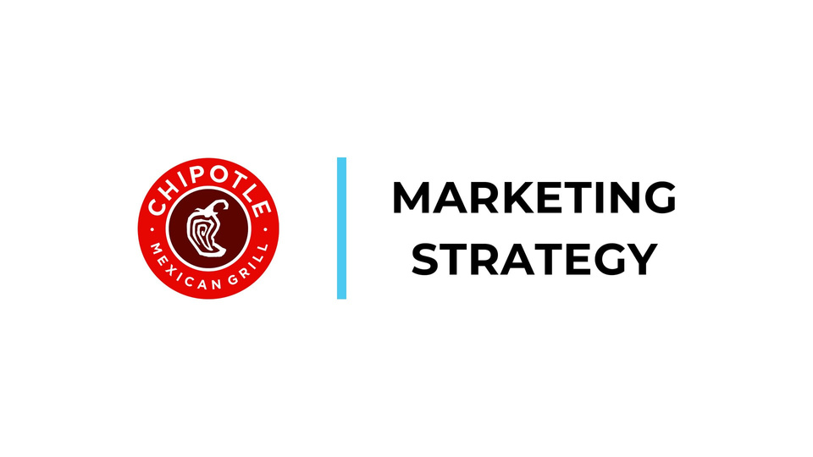

Market Structure Overview
Module 4:
Market Structure and Pricing Strategy
Market Structure: Monopolistic Competition
Key Characteristics:
Many sellers (e.g., Chipotle, Sweetgreen, Qdoba, etc.)
Differentiated products
Some pricing power
Easy entry/exit
Thesis: Differentiation is key to pricing power and consumer loyalty in fast-casual.

Slide 14
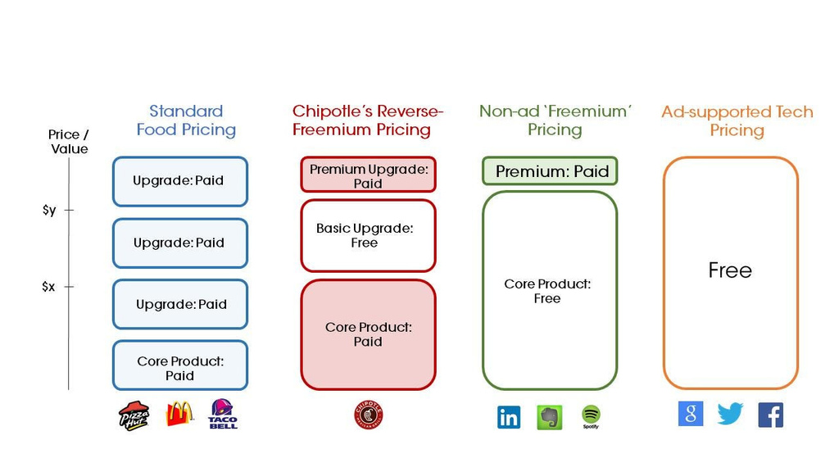

Chipotle’s
Differentiation & Pricing Power
Brand Differentiation:
Food With Integrity – fresh, ethically sourced, customizable meals
Consistent brand image: healthy, fast, customizable
Pricing Power:
Modest price increases absorbed by loyal customers.
Real-world example: Price hikes in 2022–2024 didn’t reduce traffic
Competitive Strategy:
Reinforce brand loyalty to maintain flexibility

Slide 15

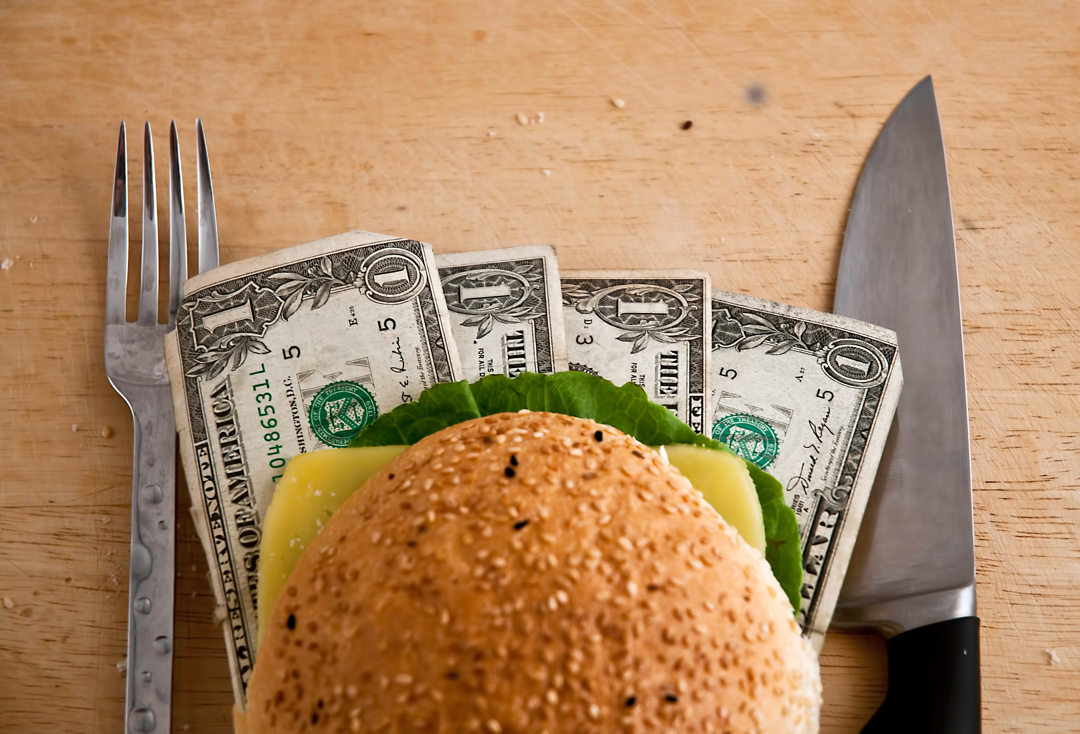

Module 5
Chipotle needs to reduce dependency on labor while maintaining service quality.
The Problem – Rising Labor Costs
Nationwide labor shortages in the restaurant industry; 70% of operators report vacancies.
Chipotle's labor costs historically make up 25–30% of revenue—pressure is increasing.
Labor costs are rising sharply—California’s $20/hr minimum wage is a major example.

Slide 16


Key tools:
Digital Makeline: Automates online order prep, improves peak-hour capacity by 20%.
Autocado: Avocado prep robot; saves $30,000+/store/year.
Chippy: Robot for chip frying and seasoning; reduces labor by 60% for that task.
Cuts costs
Increases throughput
Enhances consistency
Why automation?
Frees up staff for customer-facing roles
Automation as a Strategic Response

Slide 17




Economic Rationale
Capital for Labor Substitution: Classic microeconomic concept—shift short-run average cost curve downward.
Improves Total Factor Productivity: Same output with fewer labor hours.
Automation helps sustain profit margins without constant price increases.
Mini economic insight: This is Chipotle's way of managing a tighter labor market using technology instead of layoffs or massive price hikes.

Slide 18



Broader Benefits
Scalability: Tech solutions are replicable across 3,200+ stores.
Staff Relief: Reduces burnout by eliminating repetitive tasks.
Consistency: Robotics ensure uniform product quality, improving customer satisfaction.

Slide 19

ROI and Future Vision
Tool | Estimated Annual Savings | Operational Benefit
Autocado | $30,000+ | 50% faster guac prep
Chippy | N/A (labor reduction) | 60% less labor for chip making
Makeline | Revenue increase | +20% throughput
Break-even on robotics is often <1 year in high-wage states.
Chipotle’s $100M Cultivate Fund invests in new food tech startups (Hyphen, Vebu).

Slide 20


MODULE 6
International Trade and Global Risks
HOW GLOBAL SOURCING OF INGREDIENTS EXPOSES CHIPOTLE TO TRADE RISK
01
02
03
132M lbs of avocados sourced annually
88–90% of U.S. avocados & 97% of limes from Mexico
Heavy reliance makes Chipotle vulnerable to trade disruptions

Slide 21


2025
2020
USMCA replaces NAFTA (tariff free) Tariff- free access to Mexican produce (avocados and limes) continues.
2021
COVID AND shipping crisis increase costs
Port congestion and high freight costs affect import timing and prices.
TIMELINE: MAJOR TRADE EVENTS
2022
USDA suspends Mexican avocado imports temporarily USDA halts imports after cartel threaths ; prices spike.

Slide 22

2025
2023
Global freight rates dropped, and a strong Peruvian avocado harvest helped stabilize supply.
Freight costs drop ; Peru harvest helps restore market balance.
2024
Cartel crackdown & digital customs tech upgrades.
Improved safety in Michocan and streamlined border inspectations.
TIMELINE: MAJOR TRADE EVENTS
2025
Jalisco avocado certification expands sourcing
Avocado sourcing expands beyond Michoacan, reducing risk.

Slide 23


PANDEMIC DISTRUPTIONS AND COST SPIKES
PORT CONGESTION AND CONTAINER SHORTAGES DELAY SHIPMENTS
AVOCADO PRICES DOUBLED; LIME PRICES TRIPLED IN 2022
FREIGHT COSTS ROSE SHARPLY GLOBALLY
CHIPOTLE RESPONDED WITH MODERATE MENU PRICE INCREASES

Slide 24

SUPPLY CHAIN
Diversified sourcing: Peru, Colombia, Jalisco (2025)
Built inventory buffers to reduce vulnerability
Raised prices to offset rising input costs
Supported by USDA-SAT logistics digitization
Suggested Visual: Sourcing Map or Checklist of Risk Strategies
RESILIENCE STRATEGIES

Slide 25


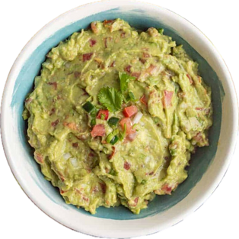
Conclusion
Economics in Action: Chipotle’s Competitive Advantage
PRICING POWER
Brand loyalty, digital platform, & premium positioning
TRADE RESILIENCE
Diversified sourcing, buffer inventory, trade adaptation
AUTOMATION & PRODUCTIVITY
Makeline tech, kitchen robotics, & labor efficiency
Notes:
Thanks to my team for breaking down those insights — and now, to wrap things up, let’s step back and look at the big picture.
What we’ve seen today is that Chipotle’s real strength isn’t just its food. It’s how the company applies economic thinking — in real time — to solve complex, high-stakes problems.
They don’t panic when wages rise — they invest in robotics. They don’t just guess what customers want — they use digital data and loyalty platforms to make sure pricing decisions are strategic. And when international trade disruptions hit, they don’t wait — they diversify suppliers and get ahead of the risk.
Each module shows how different economic levers work together. Labor, inflation, consumer behavior, competition, productivity, trade — it’s all interconnected. And Chipotle’s ability to align those forces is what gives it a sustainable edge.
So here’s the takeaway:
In a world of volatility, the companies that thrive are the ones that stay curious, stay data-driven, and stay flexible. That’s what Chipotle is doing. And as future business leaders, that’s something we can all learn from.

Slide 26
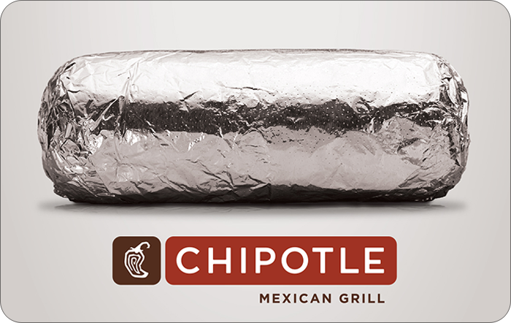

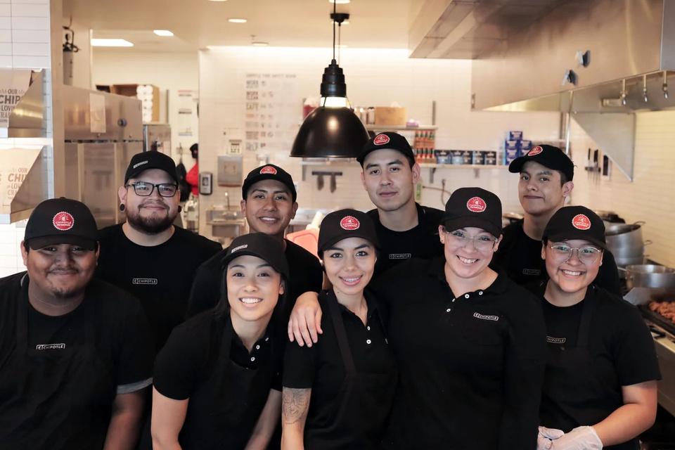

Thank You
Notes:
Thanks so much for listening!!

